Slide 1
“Stock Screener for Stock Holders”
Nayan Suresh Naik
B.Tech Mechanical

Slide 2
Contents
Introduction
Purpose
System requirements
Data Flow Diagram
Flowchart
Coding
Output
Advantages
Conclusion

Slide 3
Introduction
Technical Analysis Stock Screener mainly displays the list of stocks to the user and it give recommendations.
It give recommendations based on the averages calculated between the latest 10 days Stock records average to the latest 50 days average Stock record Based on these difference between averages It provides recommendations like Buy, Sell or Hold.

Slide 4
Purpose
The main purpose of this project is to give recommendations to the Stock Holders
It gives recommendations like Buy, Sell or hold.
Time Saving
Easily Accessible
No Installation required

Slide 5
System Requirements
Language Used : C language
Tools Used : Make, Valgrind
Compiler : Gcc
Environment : Linux

Slide 6
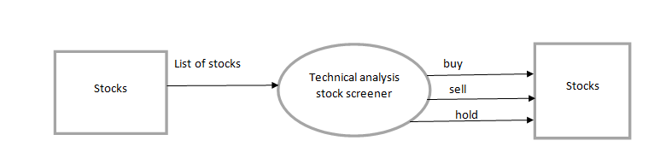
Data Flow Diagram

Slide 7
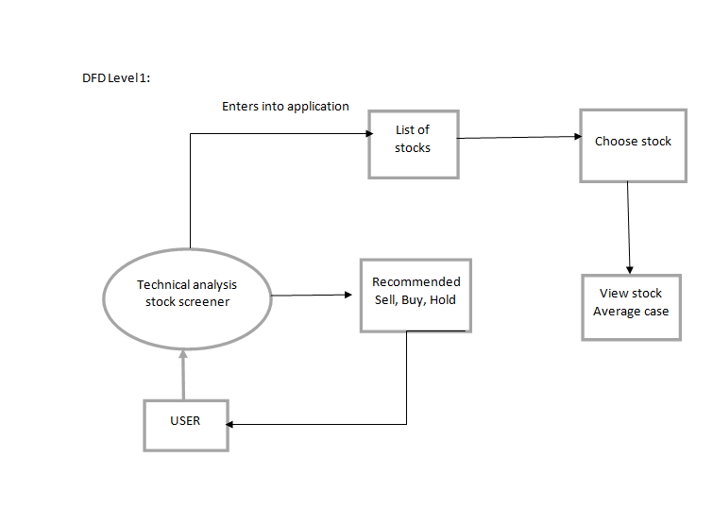
DFD-level 1

Slide 8
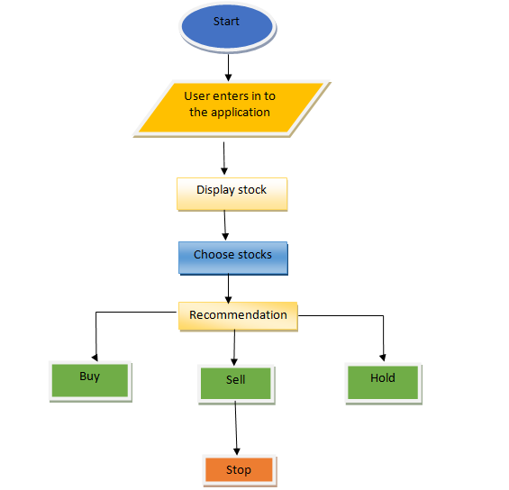
Flow chart

Slide 9
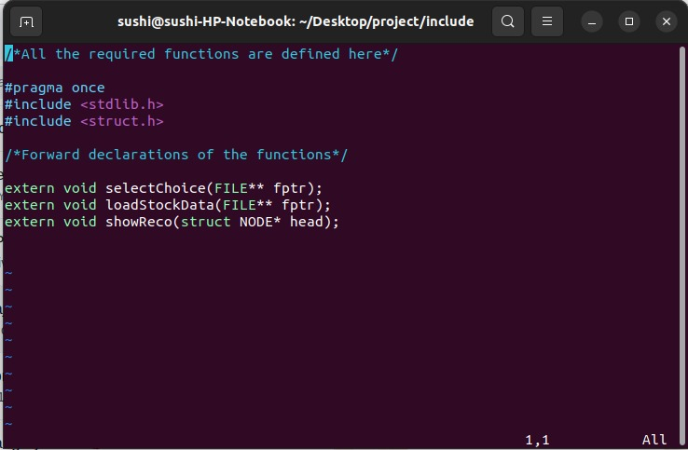
Coding
Main.h

Slide 10
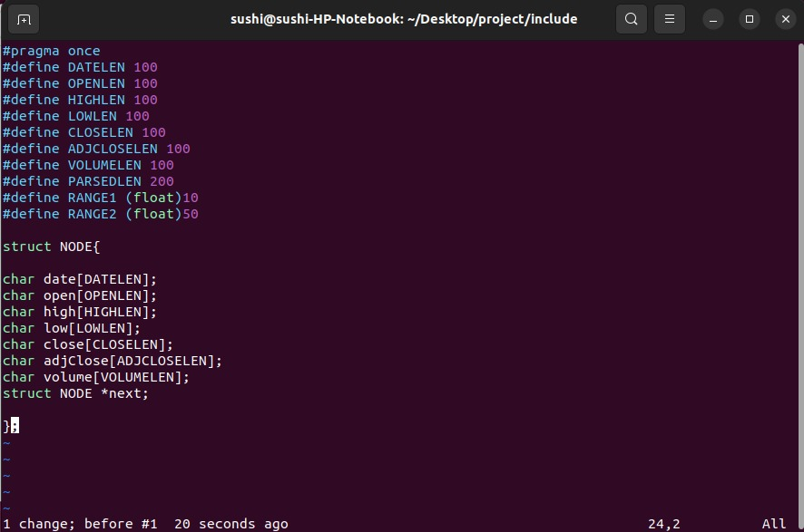
Struct.h

Slide 11
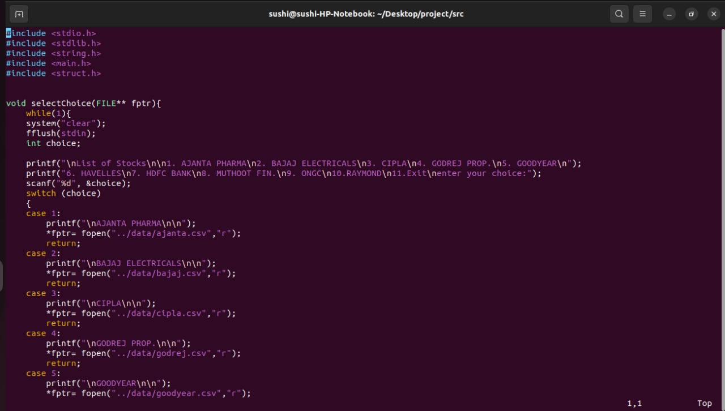
selectChoice ()

Slide 12
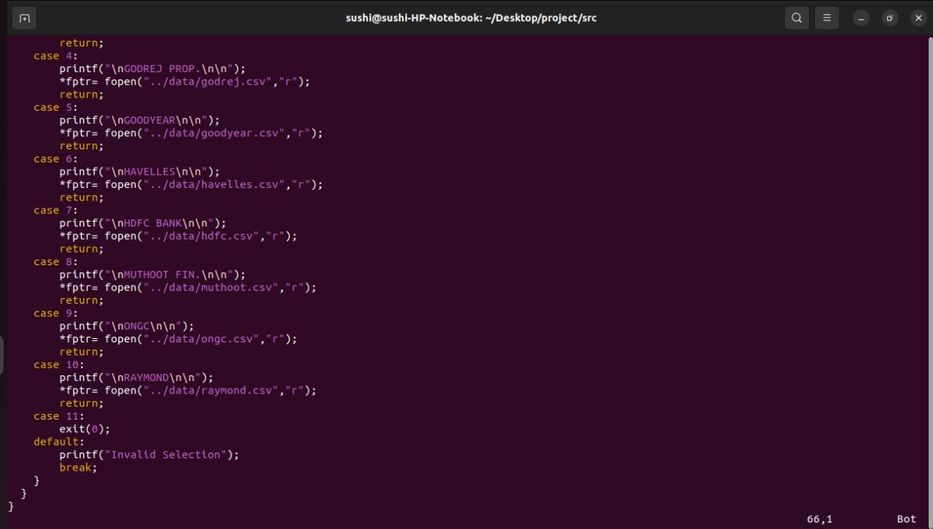
SelectChoice ()

Slide 13
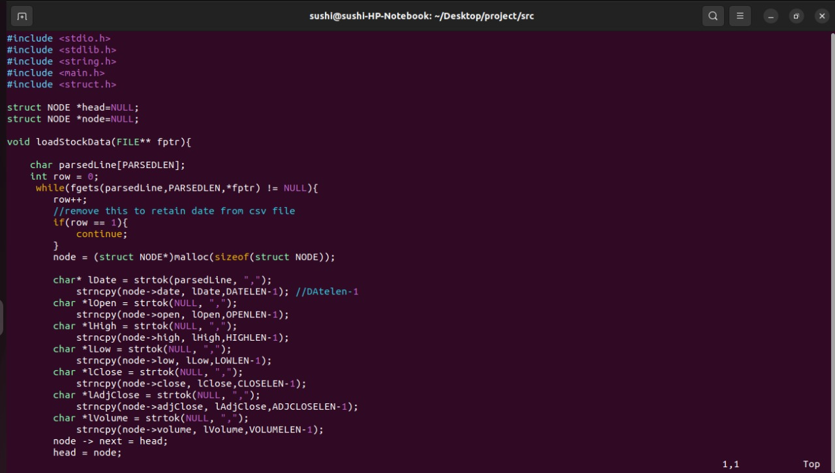
loadStockData ()

Slide 14
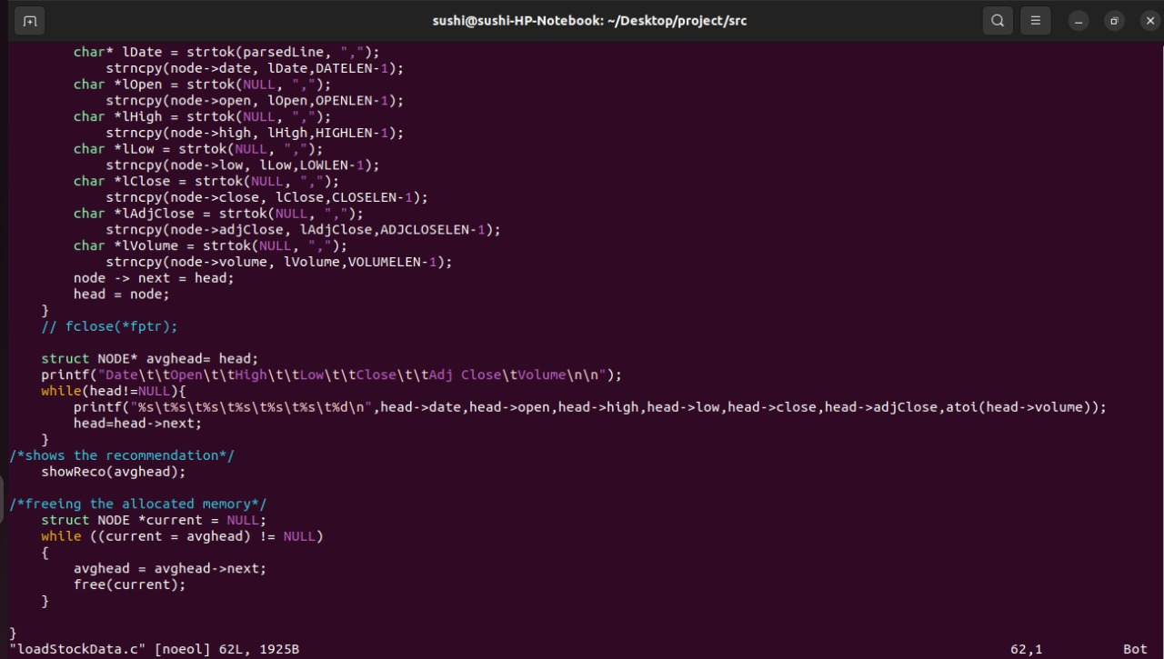
loadStockData ()

Slide 15
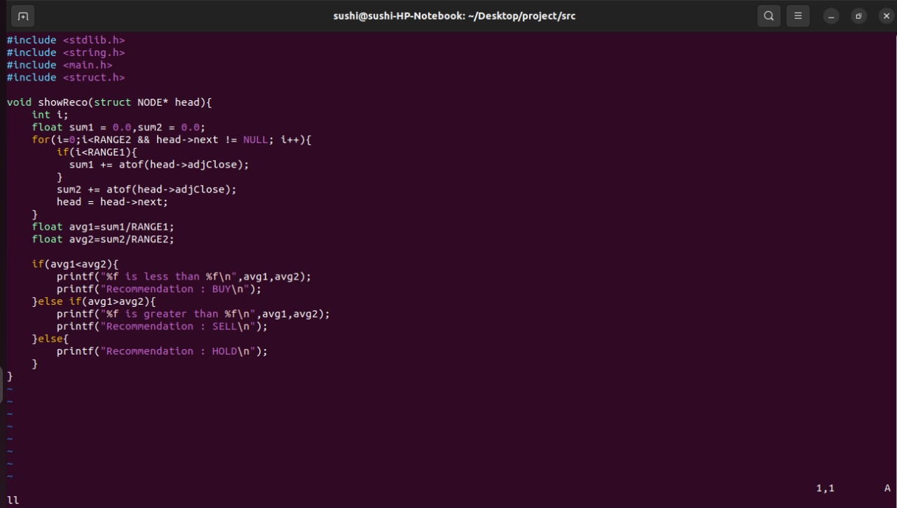
showRecommendations ()

Slide 16
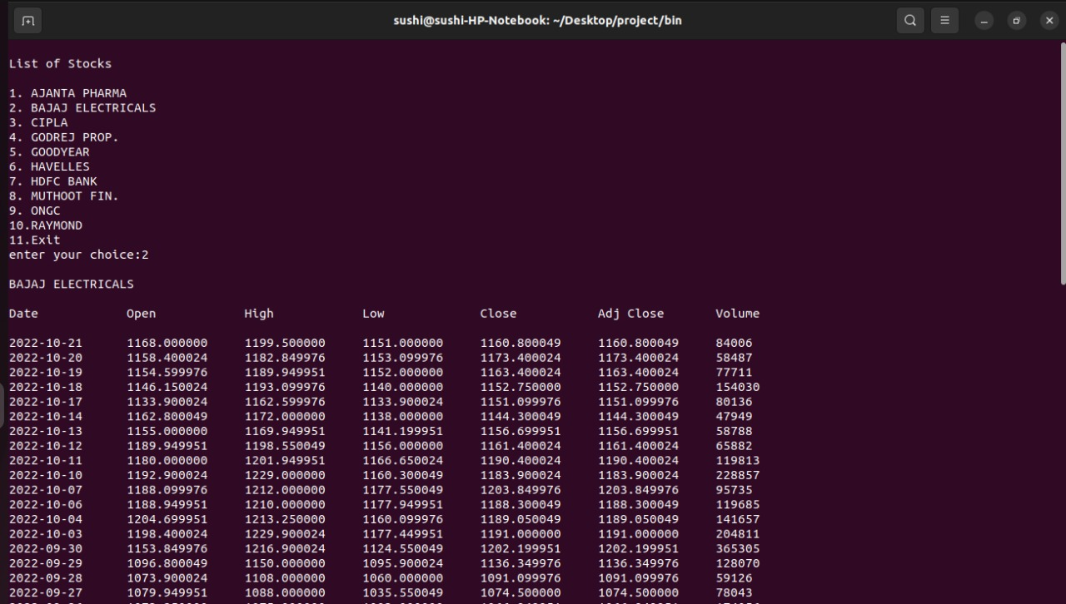
List of stocks:

Slide 17
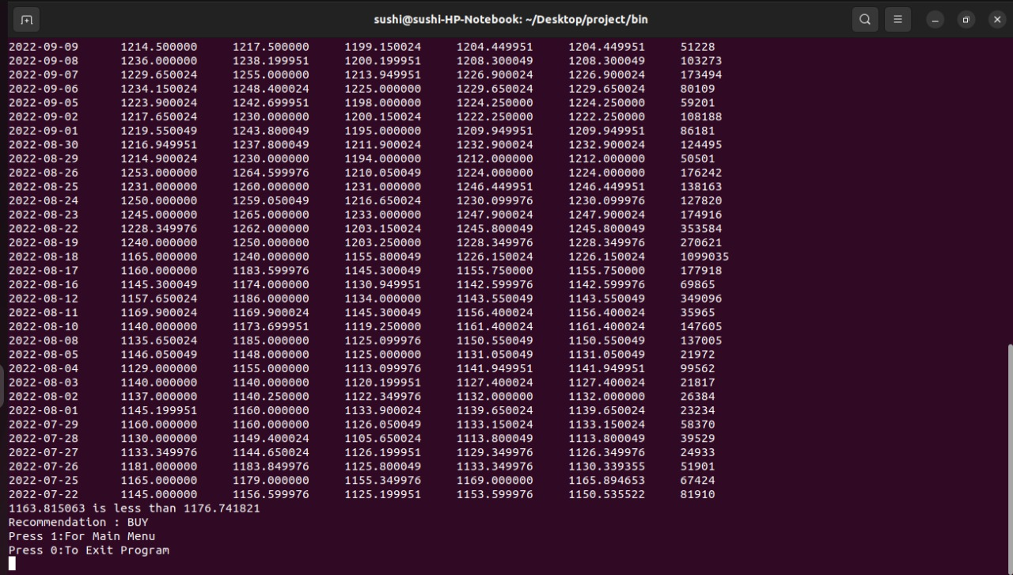
output

Slide 18
Advantages
The main Advantage is it saves the User time.
Easily Accessible
It presents new investment opportunities to the stock Holders.
It doesn’t need any installations.

Slide 19
Conclusion
The main purpose of this application is to provide the accurate recommendations to the user based on technical Analysis.
So, the user can easily access the information from the Application

Slide 20
Thank you

